Slide 1



CyberMind AI
SOCCA - MSC DS
Project Review – II
AI-Powered Cyber Intelligence Platform
Presented by Daksh Vasani
ER. NO: 2504070500037

Slide 2
Project Overview
CyberMind AI is an AI-powered Cyber Threat Intelligence and Malware Analysis Platform designed to consolidate heterogeneous sources and provide concise, actionable outputs for analysts. The system integrates rule-based scanners, machine learning detectors and generative AI explanations to produce a unified 0–100 cyber risk score and automated reports.
10 Specialized Scanners
30+ External TI APIs
Machine Learning
Generative
AI
Modular scanners for multi-vector analysis (URL, file, IP, device, etc.).
Aggregated feeds for enrichment and reputation scoring.
Supervised classifiers and feature-based detectors for anomalies and malicious patterns.
Contextual explanations and remediation guidance using LLM models.
2
CyberMind-AI

Slide 3
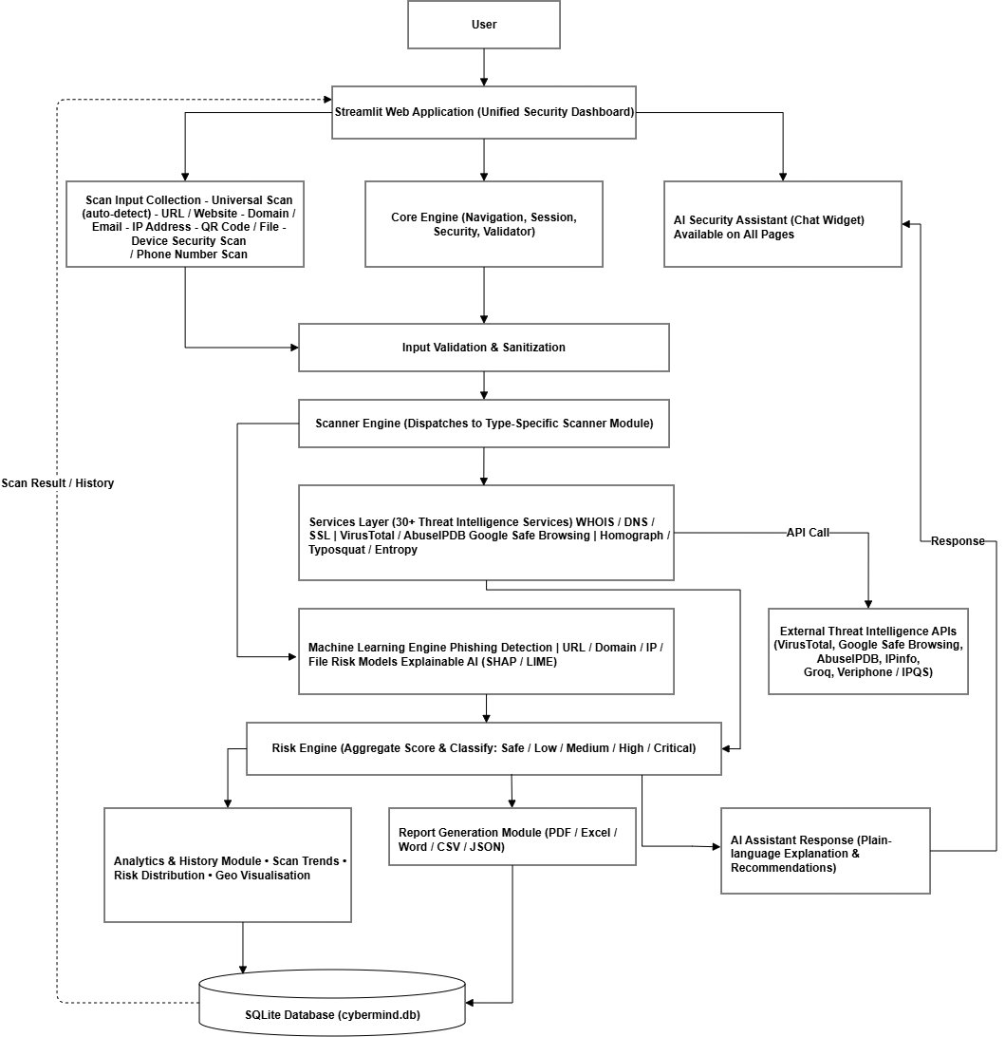
System Architecture
Architecture Highlights:
Decoupled 3-Tier Design: Presentation, Application, and Data layers are strictly separated for modular maintainability.
Provider-Agnostic Services: External APIs are queried exclusively from services/, keeping core scanner logic vendor-independent.
Dual ML + LLM Integration: Combines Scikit-Learn Random Forest classifiers with Groq Llama-3 70B generative AI.
Centralized Telemetry: All scan logs, API latency records, and PDF report paths are persisted in SQLite database.
3
CyberMind-AI

Slide 4
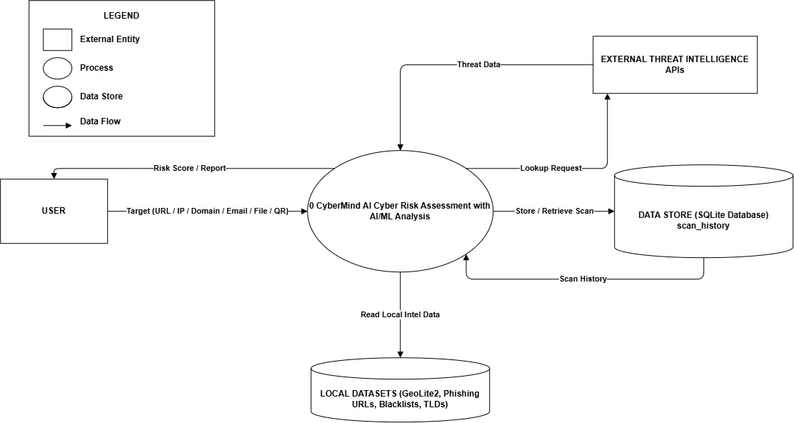
Data Flow Diagram
DFD LEVEL 0 — CONTEXT DIAGRAM
User / Analyst Entity: Submits raw target input (URL, IP, Phone, File) ➔ Receives threat score, gauge meter, & PDF report.
Process 0.0: CyberMind AI Threat Intelligence Platform (Central Processing Unit).
External Threat APIs Entity: Receives target queries ➔ Returns live REST JSON threat payloads.
SQLite Data Store: Persists telemetry in scan_history master database table.
4
CyberMind-AI

Slide 5
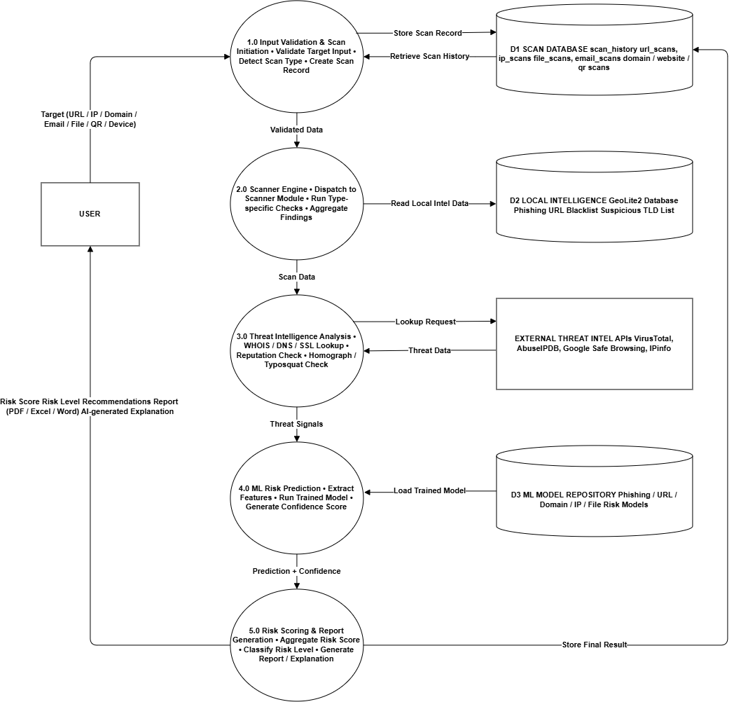
Data Flow Diagram
DFD LEVEL 1 — 5 SUB-PROCESSES
Process 1.0 Input Validation: Sanitizes & validates target inputs via core/validator.py.
Process 2.0 Scanner Engine: Dispatches target to specific scanner module in modules/.
Process 3.0 Service / API Execution: Queries 30+ REST APIs in services/*_service.py.
Process 4.0 ML Risk Assessment: Evaluates ML .pkl models & computes score in modules/risk_engine.py.
Process 5.0 DB & Security Report: Stores record in database/cybermind.db & exports PDF report.
5
CyberMind-AI

Slide 6
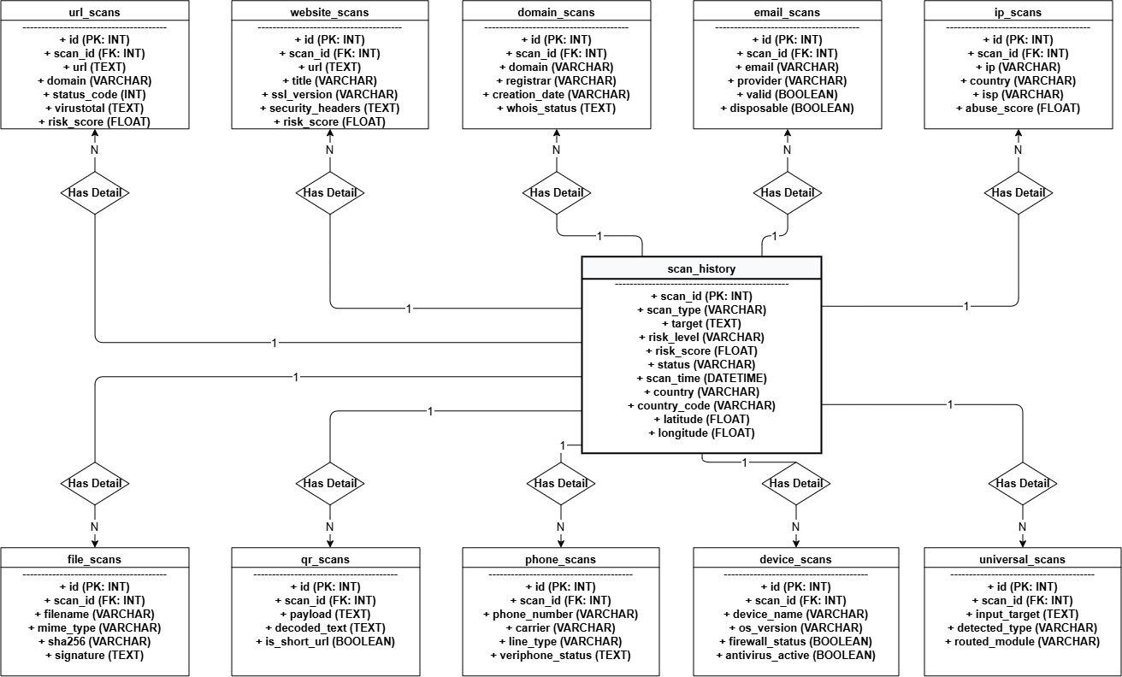
ER Diagram & Database Design
DATABASE TABLES ORGANIZATION
Master Entity (Rectangle): SCAN_HISTORY (Central log table with scan_id Primary Key).
10 Scanner Detail Entities: phone_scans, url_scans, file_scans, ip_scans, website_scans, domain_scans, email_scans, qr_scans, device_scans, universal_scans.
Relationship Diamonds: <Has_Phone_Data>, <Has_URL_Data>, etc., linking SCAN_HISTORY to each detail table in a 1-to-N (1:N) cardinality via scan_id Foreign Key.
Attribute Ovals: Key fields including target, risk_score, risk_level, carrier, line_type, sha256, abuse_score.
6
CyberMind-AI

Slide 7
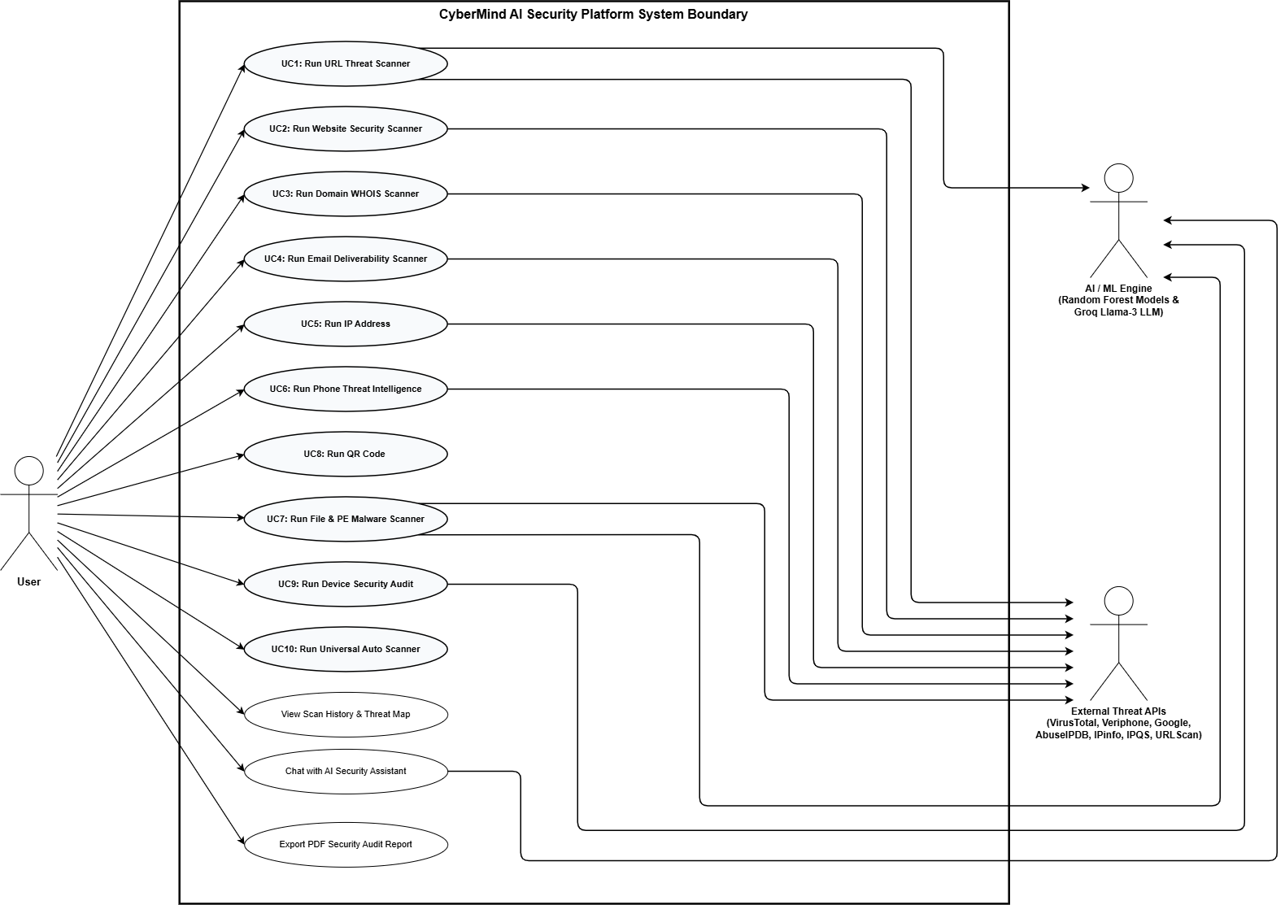
UML Design
Use Case Diagram
Models system functionalities & actors:User Actor: Triggers 10 module scans, views history, downloads PDF.
Threat API Actor: Connects to 8 API-driven modules.
AI/ML Actor: Connects to ML models & Groq LLM.
IEEE Standard: 0 line crossings.
7
CyberMind-AI

Slide 8
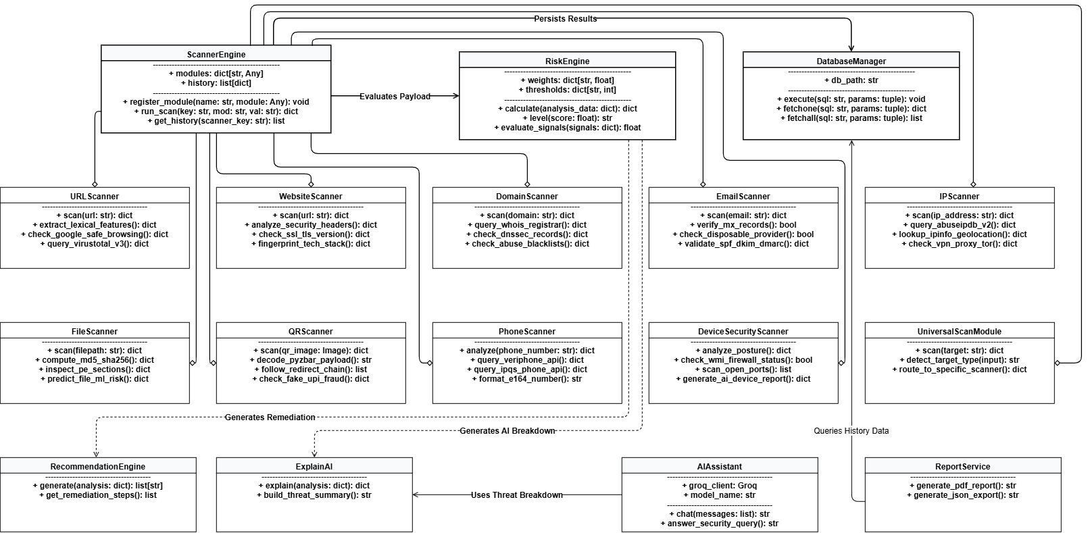
UML Design
Class Diagram
Models 4-tier static structure:
Tier 1: ScannerEngine, RiskEngine, DatabaseManager.
Tier 2 & 3: 10 Scanner Classes (URL, Phone, File...).
Tier 4: ExplainAI, AIAssistant, ReportService.
Aggregation: ScannerEngine holds 1:N scanners.
8
CyberMind-AI

Slide 9
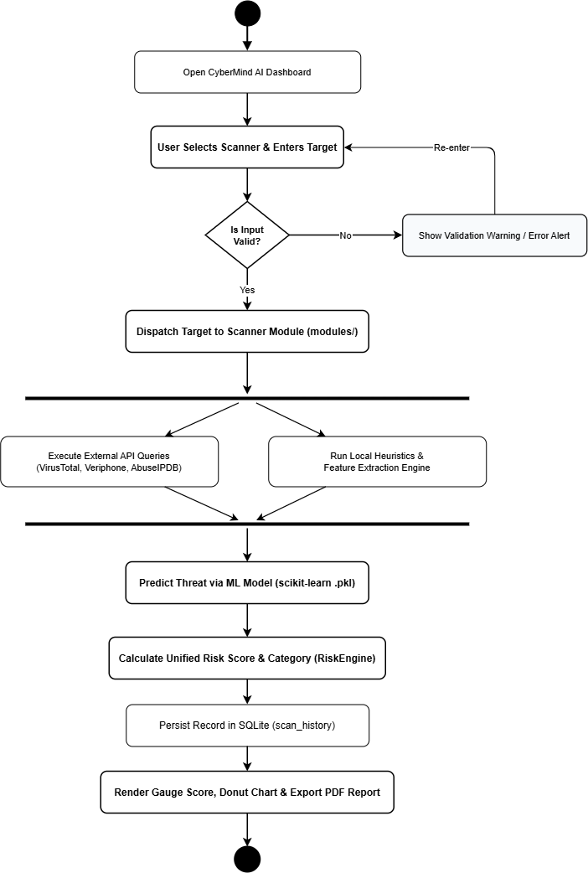
UML Design
Activity Diagram
Input Validation: User submits a target → system sanitizes and validates the input → invalid inputs trigger an alert; valid inputs go to the Module Router.
Parallel Processing: The system simultaneously performs API threat analysis, ML analysis, and local intelligence checks.
Threat Aggregation: Results are combined → Unified Risk Engine calculates a 0–100 risk score and severity → Groq Llama-3 generates the threat explanation.
Persistence & Output: Results are stored in SQLite → analytics are displayed on the Streamlit dashboard → optional PDF/JSON report is generated.
9
CyberMind-AI

Slide 10
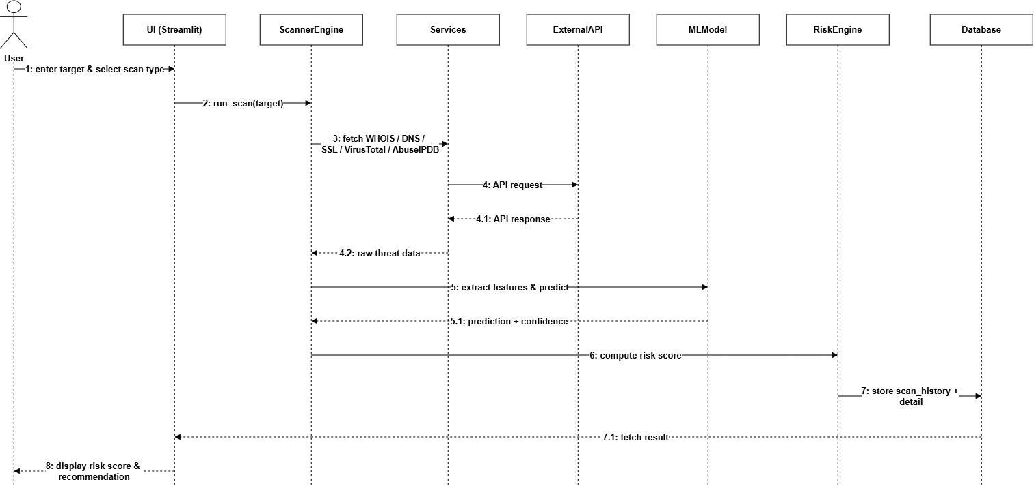
UML Design
Sequence Diagram
Models threat scan lifecycle (10 steps):
User ➔ UI ➔ Validator ➔ Scanner Engine ➔ External Threat API / ML Model ➔ RiskEngine ➔ SQLite DB ➔ Streamlit Dashboard.
Fault Tolerance: Fallback if API times out.
Sub-3 Second Execution.
10
CyberMind-AI

Slide 11
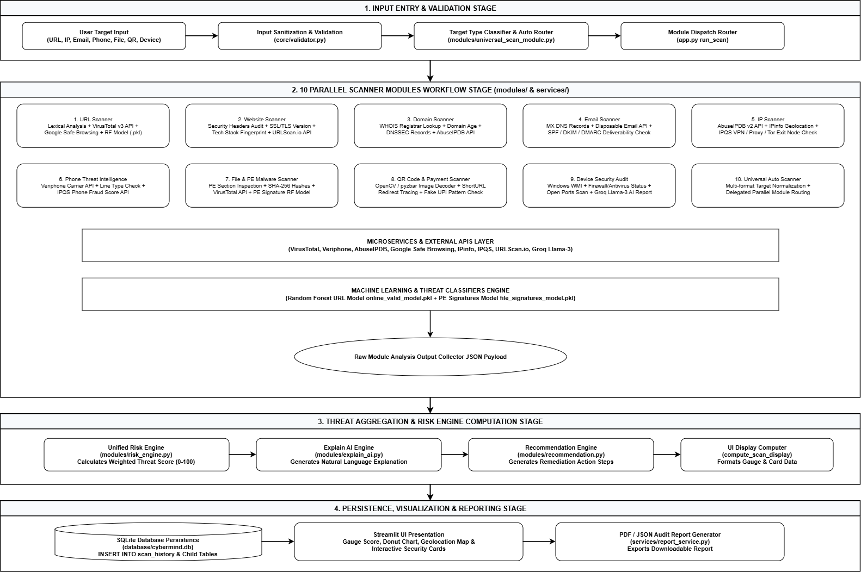
Model Planning
11
CyberMind-AI

Slide 12
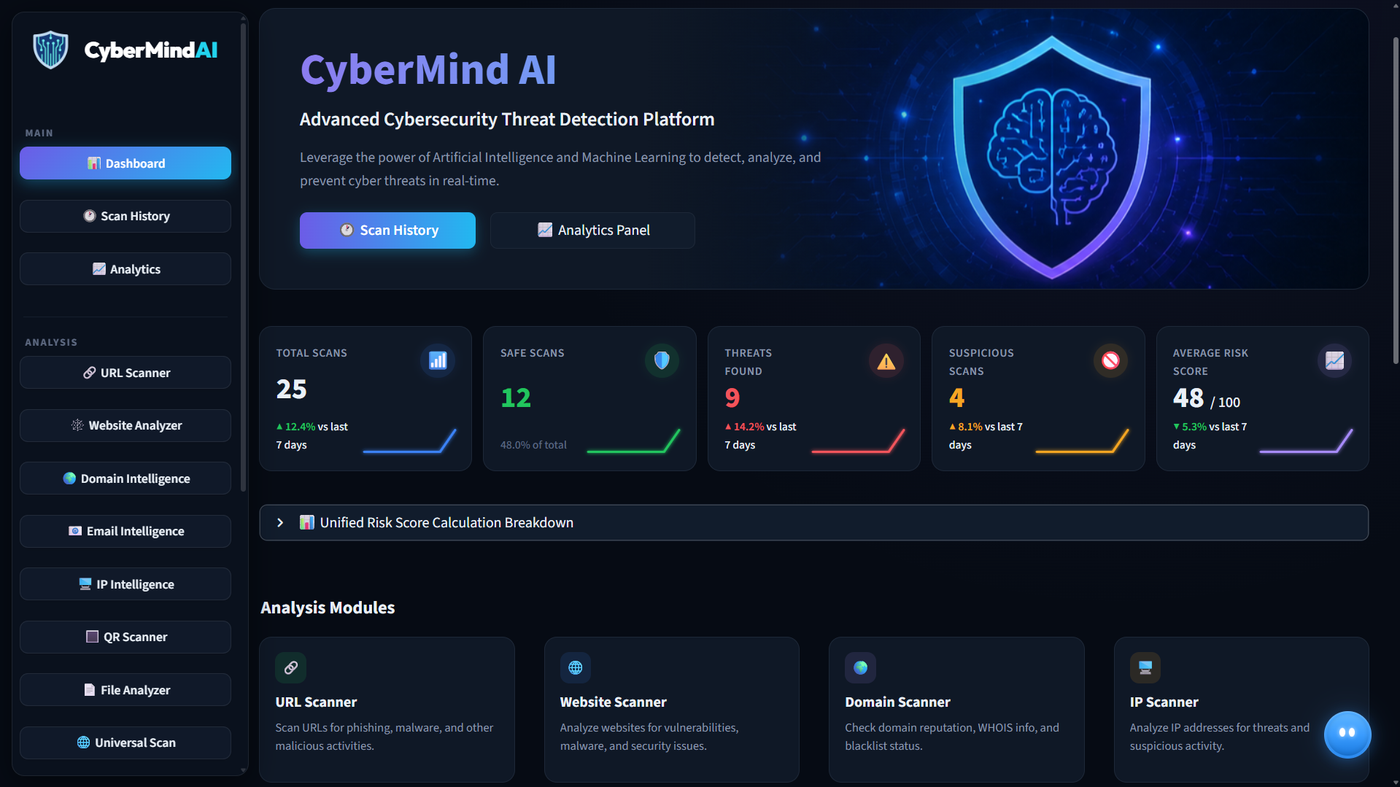
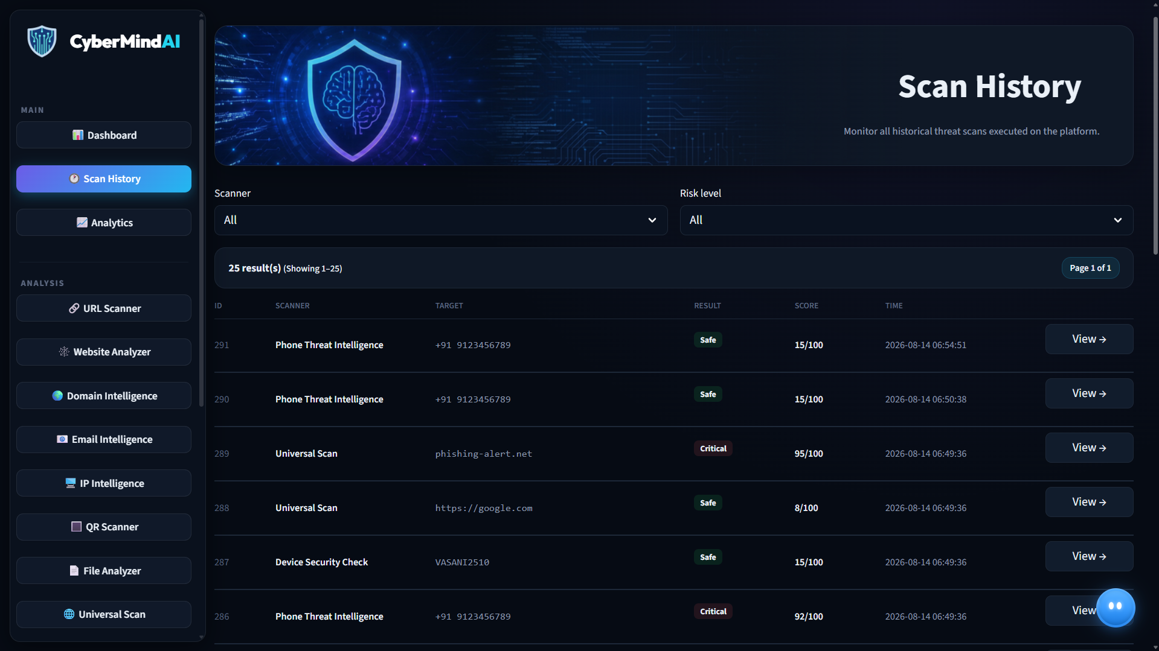
UI Prototype
Dashboard
Scan History
12
CyberMind-AI

Slide 13
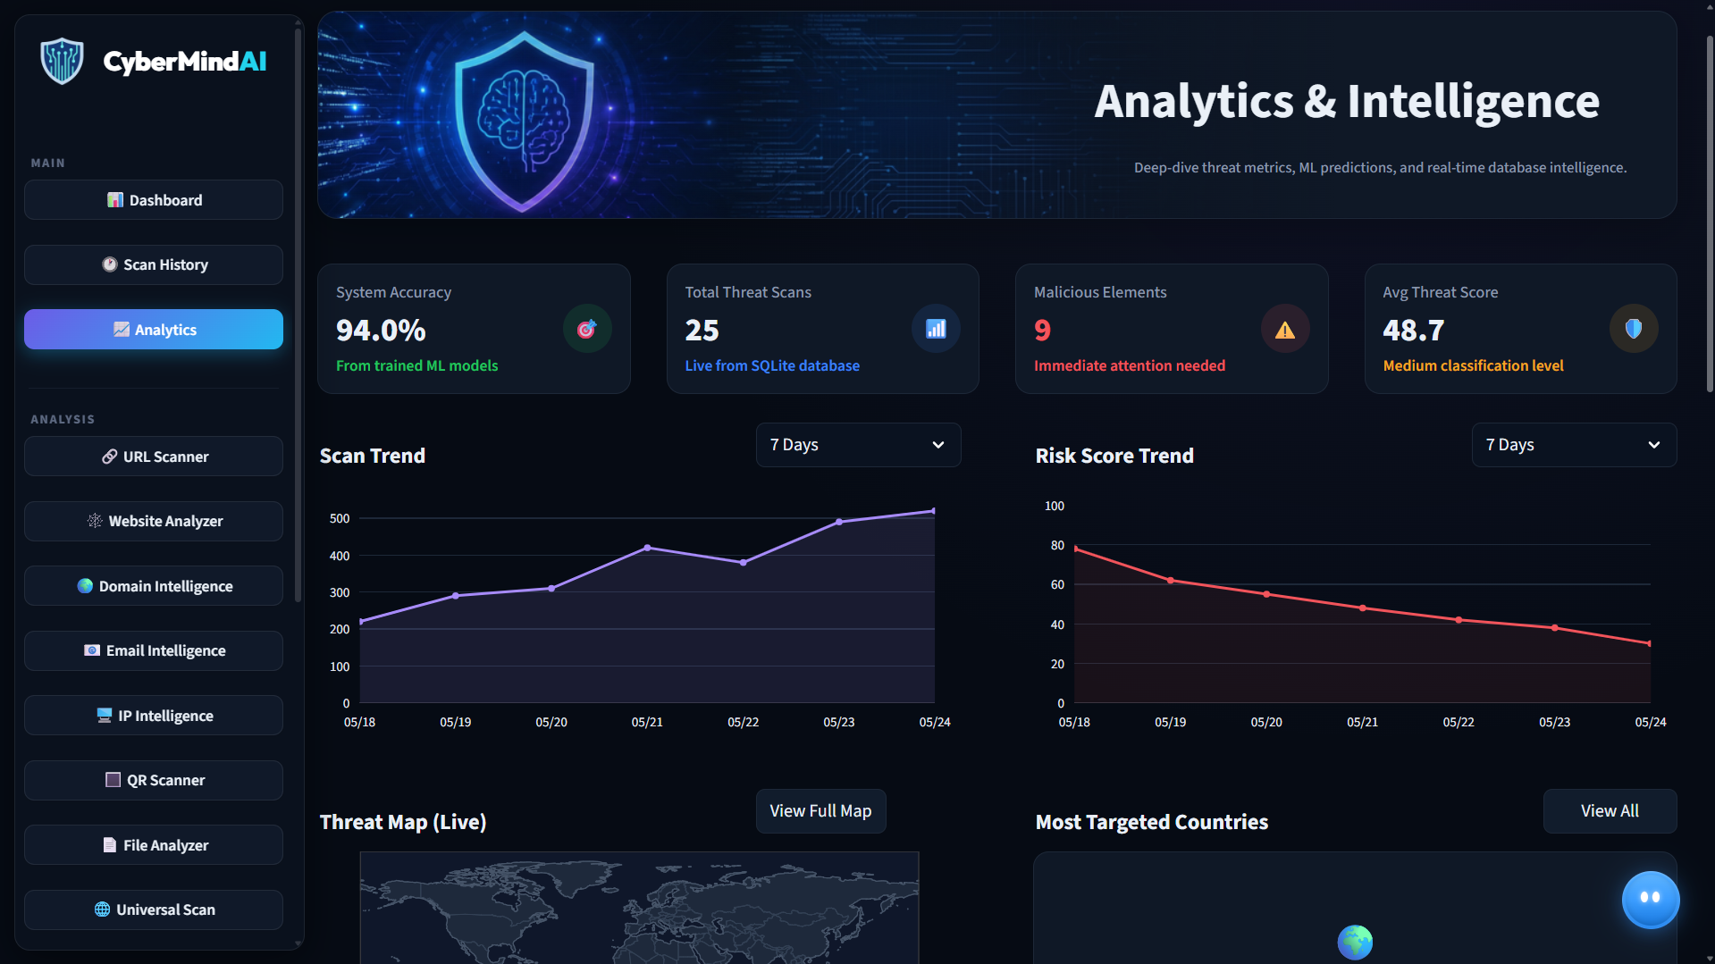
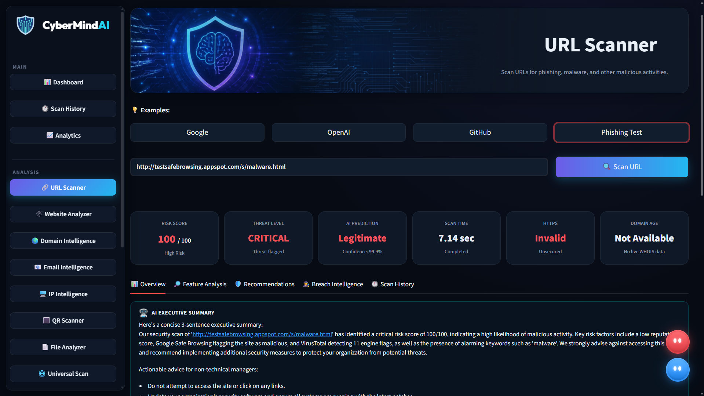
UI Prototype
Analytics
URL Scanner
13
CyberMind-AI

Slide 14
Current Project Progress — Review 2 Status
REVIEW 2 COMPLETED DESIGN MILESTONES
NEXT PHASE — IMPLEMENTATION ROADMAP
✔ Requirement Analysis & Feasibility Study
✔ Decoupled 3-Tier System Architecture Design
✔ Data Flow Diagrams (DFD Level 0 & Level 1)
✔ Peter Chen Style ER Diagram (15 DB Tables)
✔ 4-Tier UML Class Diagram & Sequence Diagram
✔ 10 Scanner Modules & Veriphone API Integration
✔ Streamlit UI Dashboard & Prototype Layouts
Complete System Testing & Accuracy Benchmarking
Enterprise SIEM / SOAR Webhook Connectors
Dynamic Malware Detonation Sandbox Integration
Automated Windows Firewall Active Response Scripts
Final Project Report Documentation & Deployment
14
CyberMind-AI

Slide 15
CyberMind-AI
SOCCA - MSC DS
Thank You!
For Your Attention
Stay Secure, Stay Smart, Stay Ahead.
Presented by Daksh Vasani
ER. NO: 2504070500037

